Slide 1

RUNGTA COLLEGE OF DENTAL SCIENCES & RESEARCH
CARIES RISK ASSESSMENT AND MANAGEMENT
DEPARTMENT OF PEDODONTICS AND PREVENTIVE DENTISTRY

Slide 2
Specific learning Objectives
Core | Domain
Introduction Definition Changing paradigms to deal with dental caries. | Advantages Caries balance/Imbalance Risk Indicators

Slide 3
CATEGORY
MUST TO KNOW
NICE TO KNOW
Microbial test for mutants streptococci detection
DESIRE TO KNOW
Salivary buffer capacity test.
Components of caries activity test.
Risk assessment.
Microbial test for lactobacilli detection.
Cariogram
Risk assessment tool

Slide 4
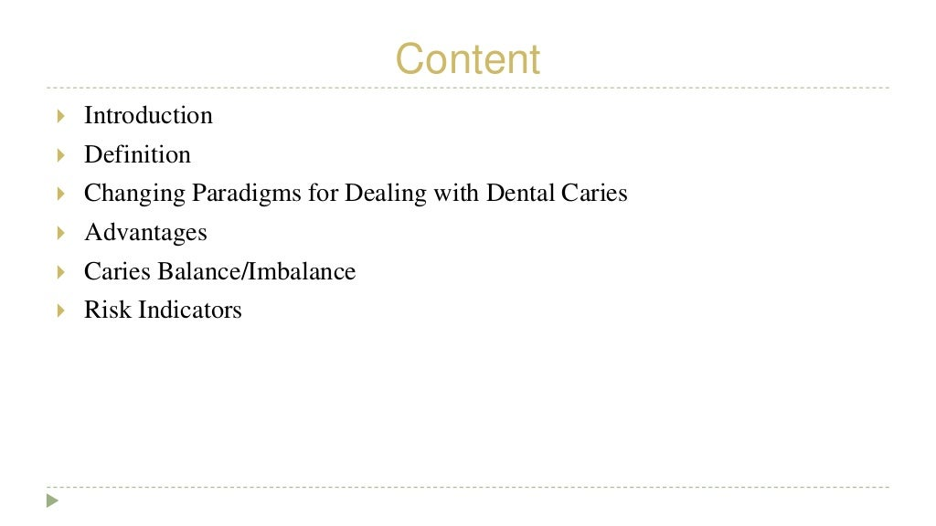

Slide 5
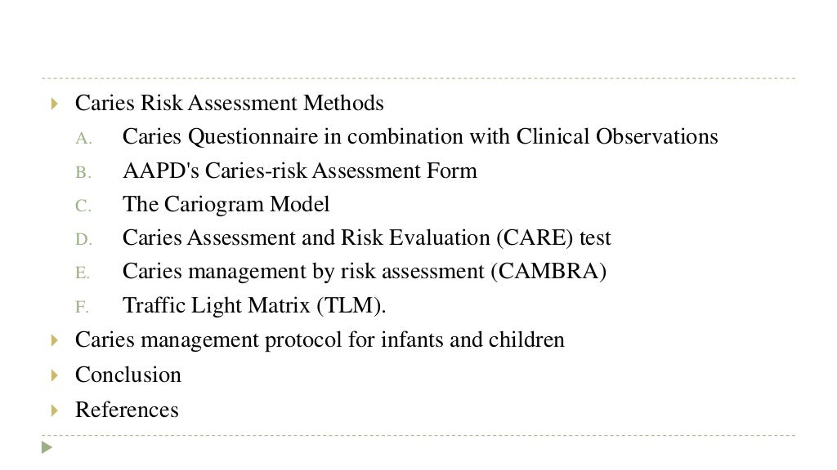

Slide 6
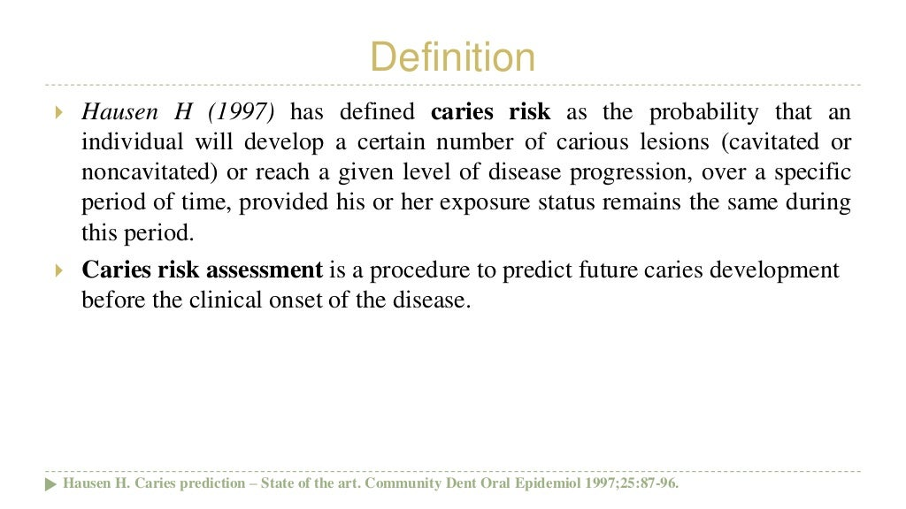

Slide 7
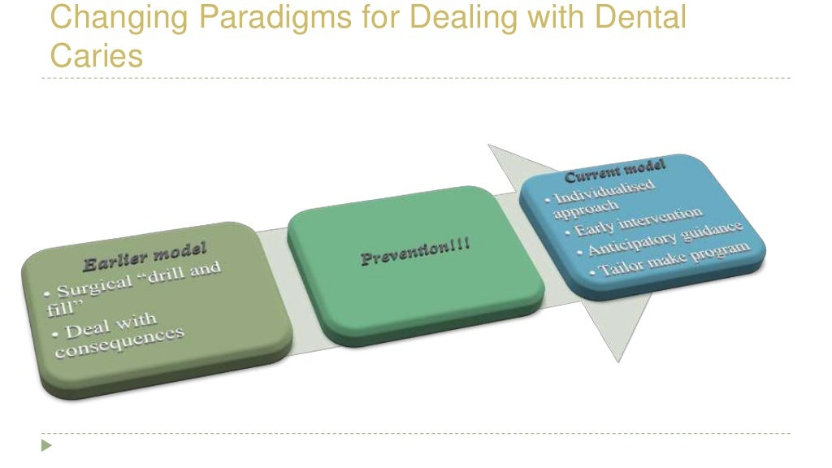

Slide 8
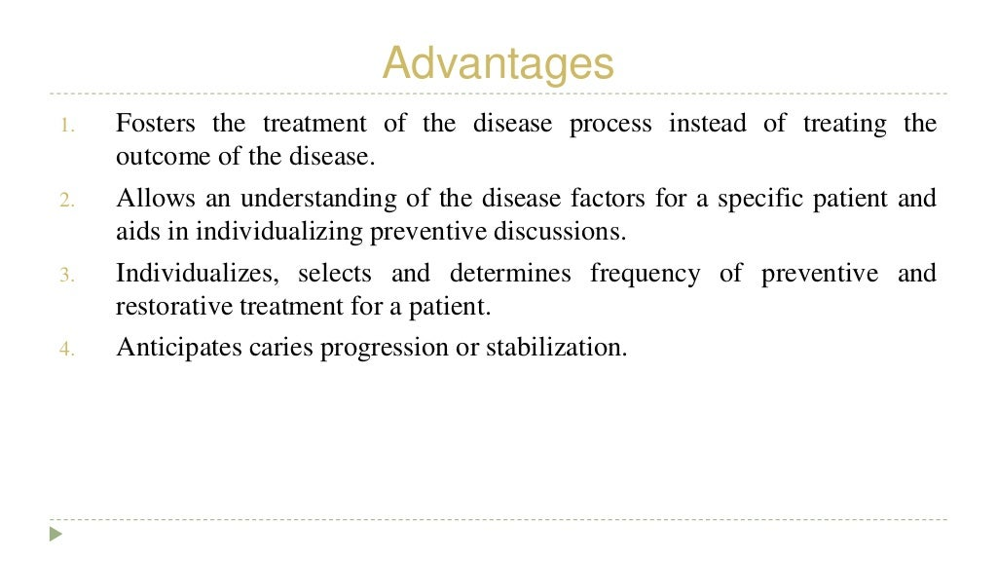

Slide 9
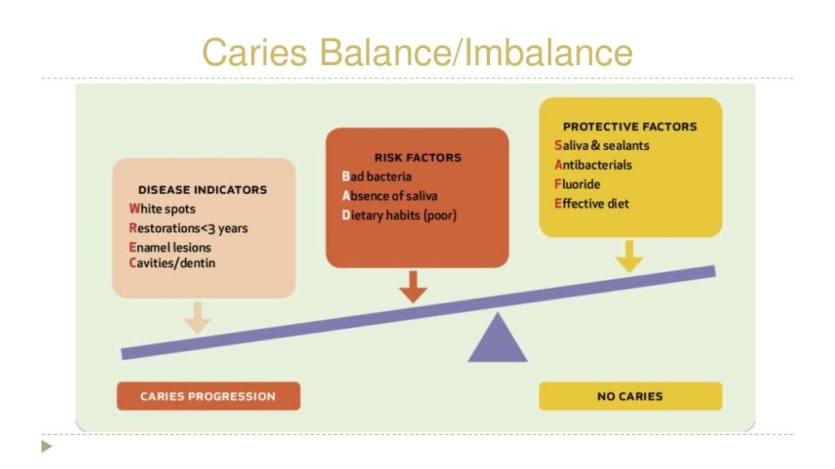

Slide 10
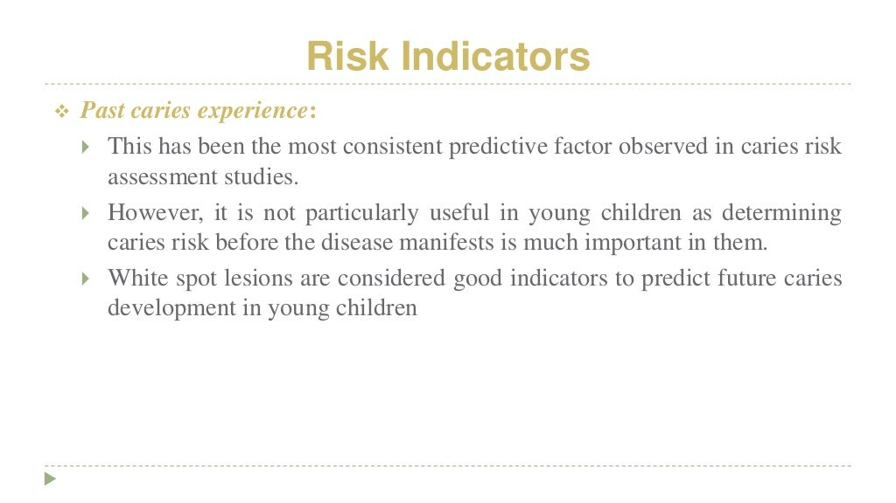

Slide 11
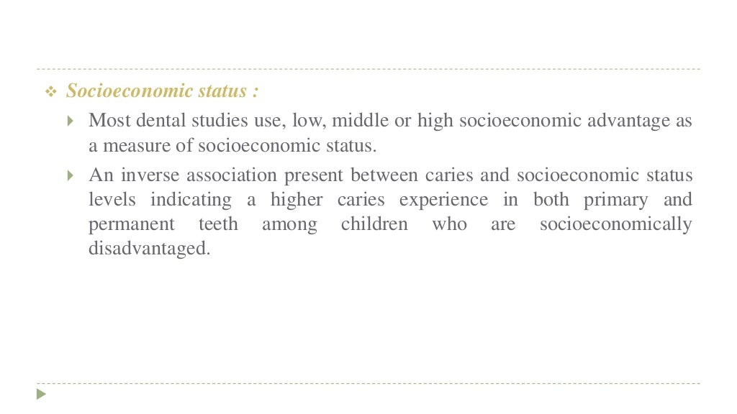

Slide 12
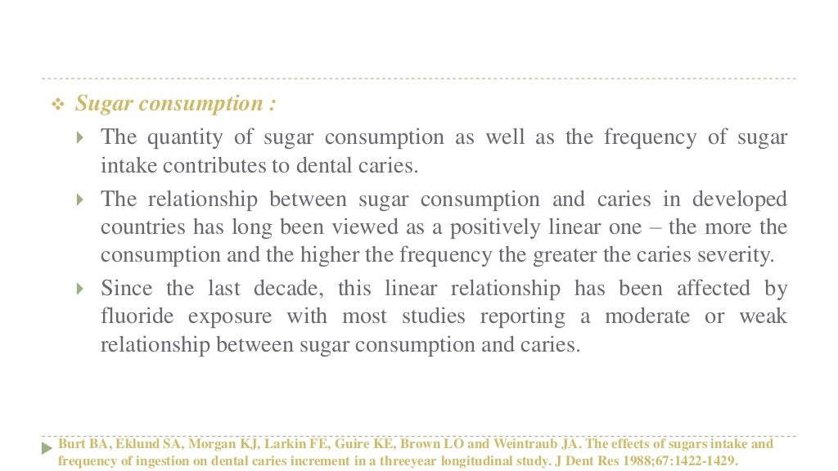

Slide 13
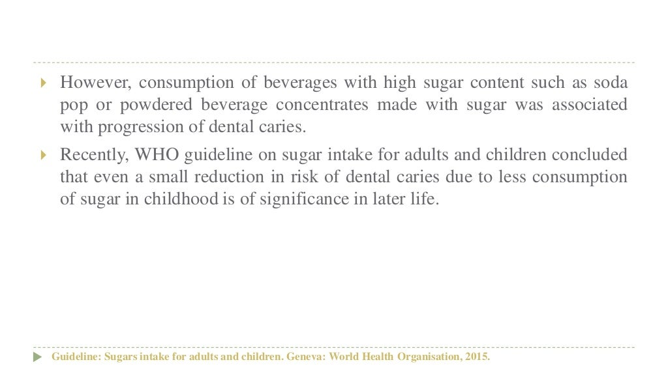

Slide 14
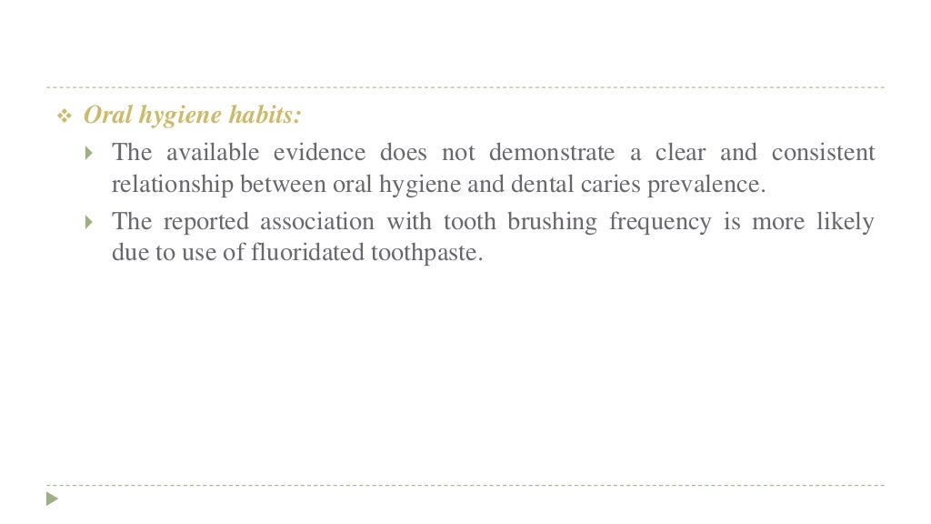

Slide 15
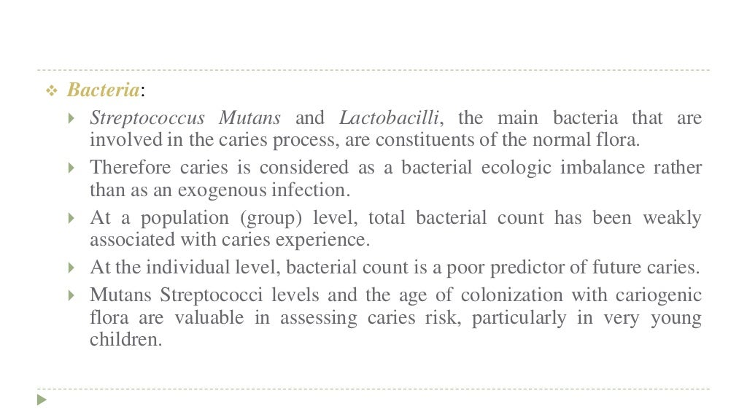

Slide 16
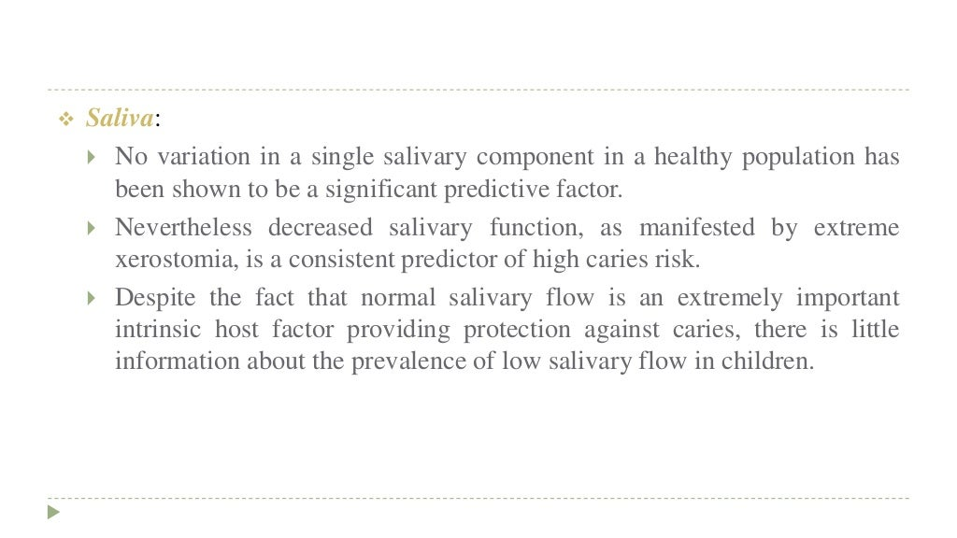

Slide 17
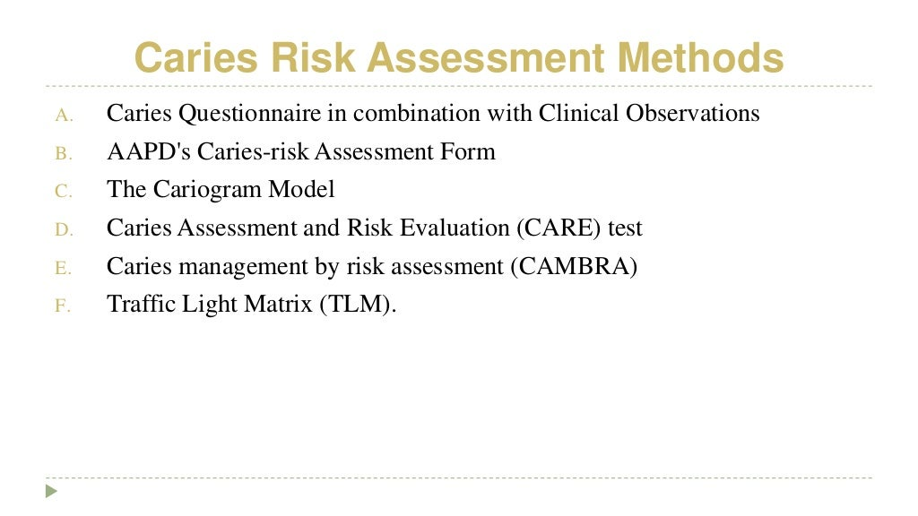

Slide 18
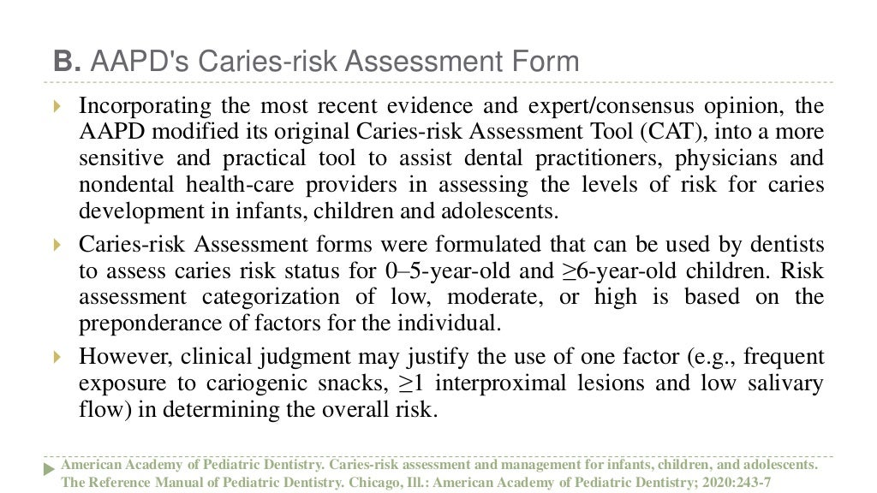

Slide 19
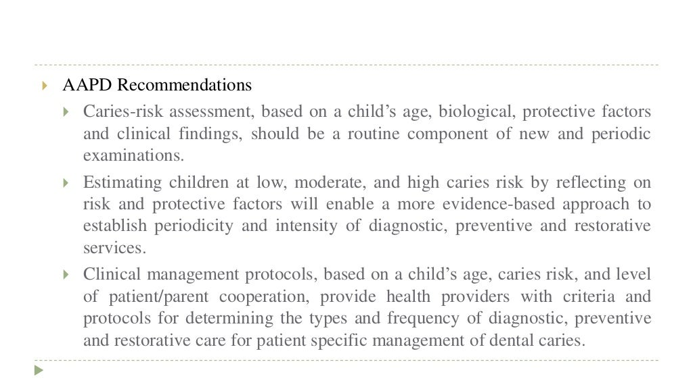

Slide 20
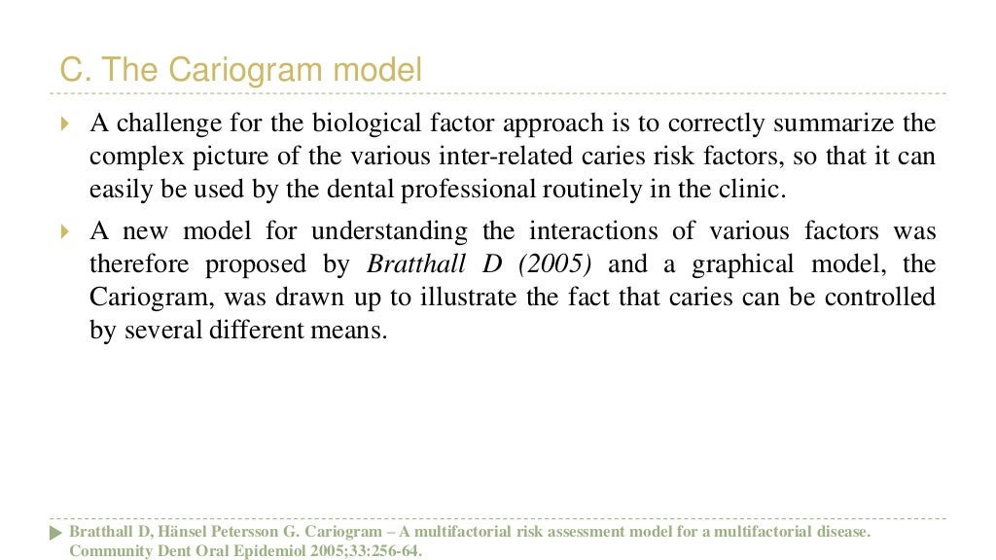

Slide 21
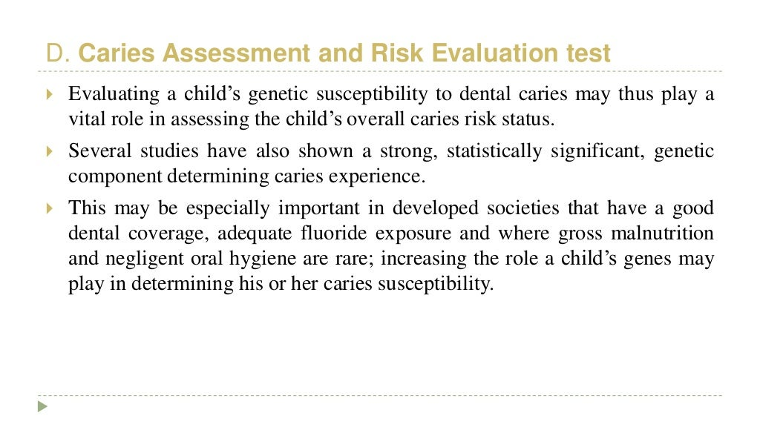

Slide 22
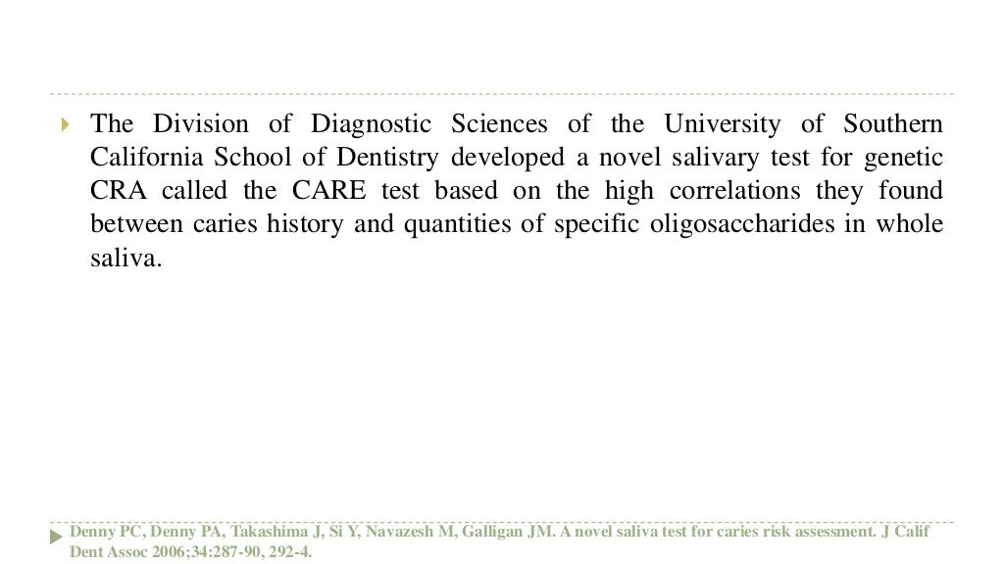

Slide 23
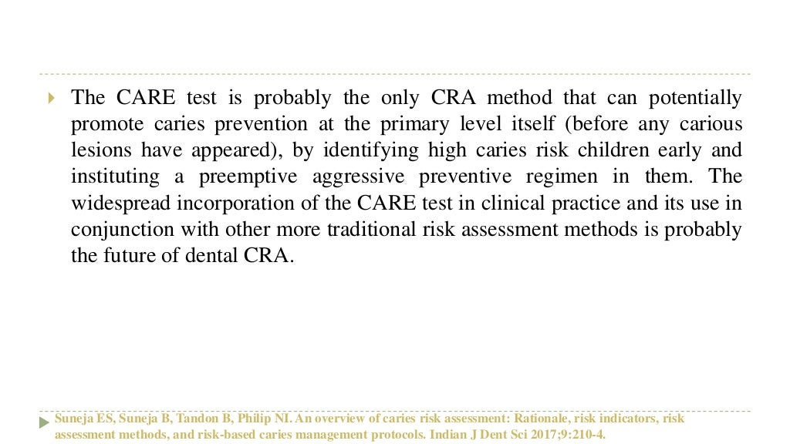

Slide 24
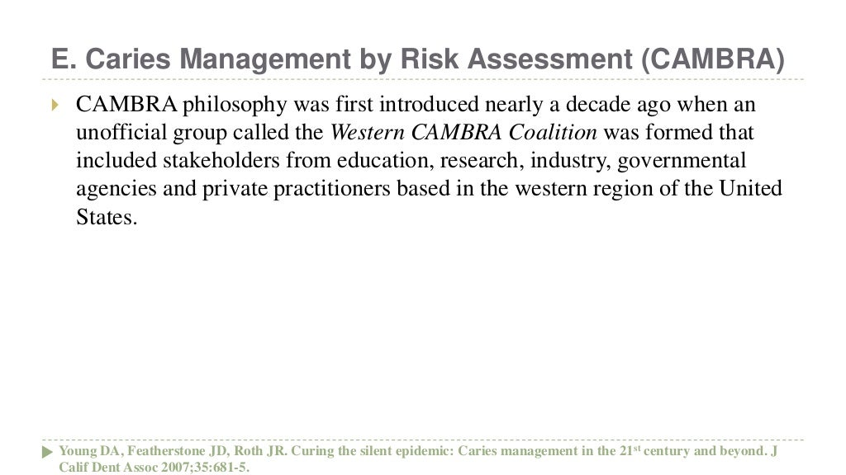

Slide 25
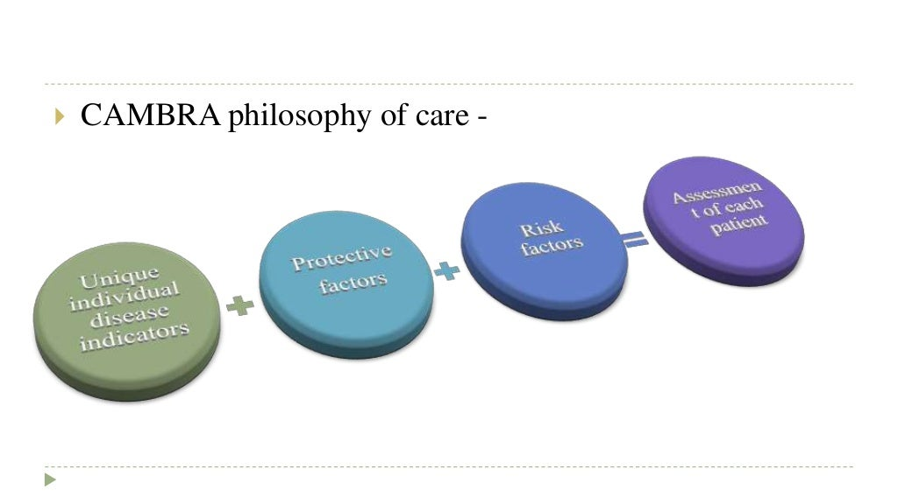

Slide 26
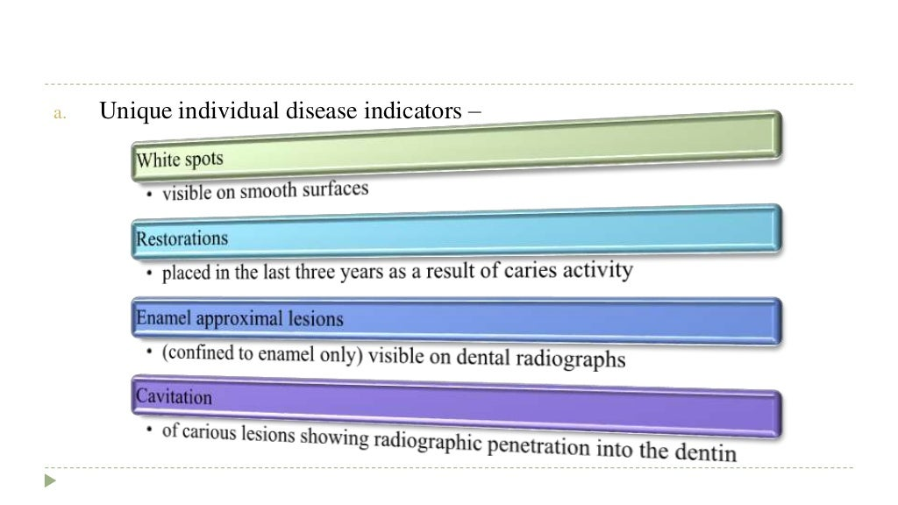

Slide 27
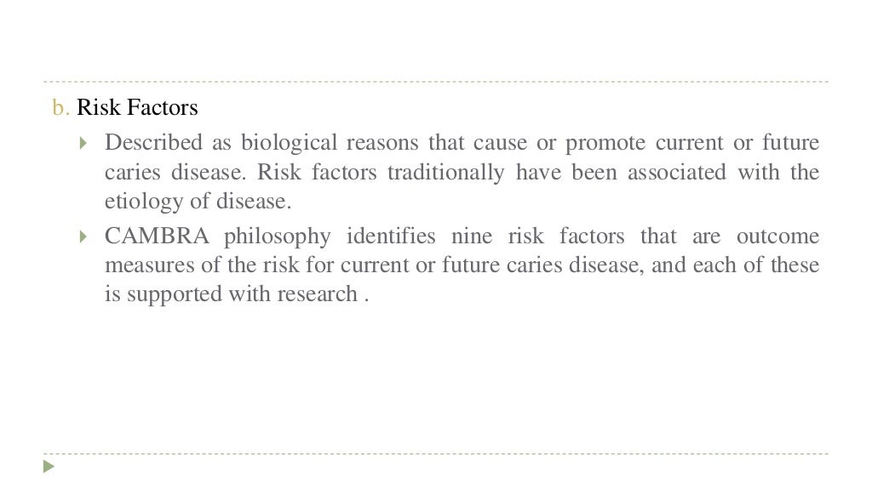

Slide 28
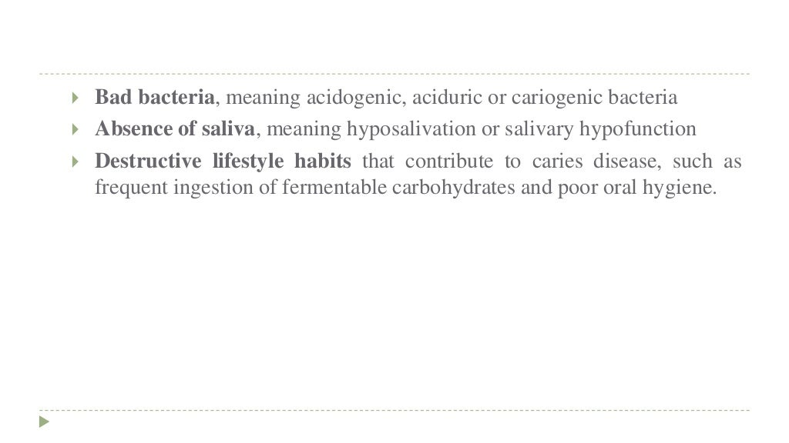

Slide 29
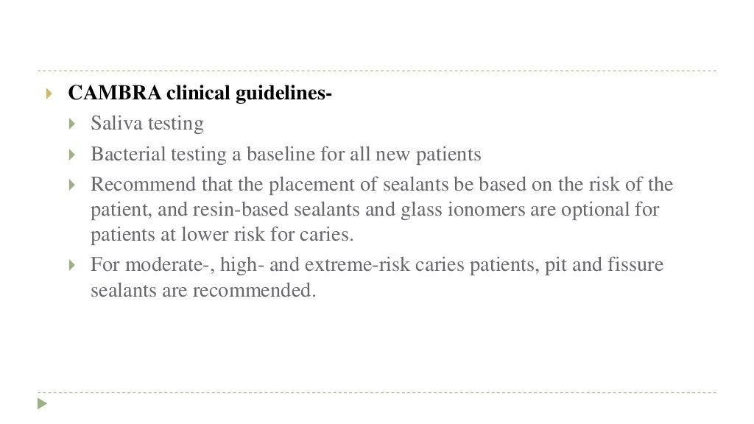

Slide 30
TAKE HOME MESSEGE
Caries risk assessment is used to determine need and extent of personalised preventive measures, Motivation of patients ,to identify high-groups.
Dentocult SM-strip mutants is used to measure strep mutant
count at chair side.
Salivary buffer capacity and ph level in saliva are correlated
to caries increment.

Slide 31
